Slide 1
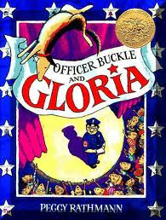
Officer Buckle and Gloria
Old Wire Road
Elementary
Kindergarten

Slide 2
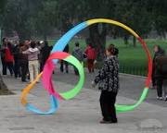
swiveled
Swiveled – to twist back and forth
  The ribbon swiveled in the air.

Slide 3
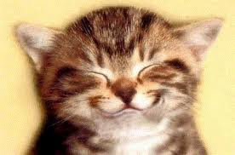
Grinned
Grinned – smiled really big.
  He grinned from ear to ear.

Slide 4

Discovered
Discovered – to find or see before anyone else.
The little boy discovered the treasure.

Slide 5
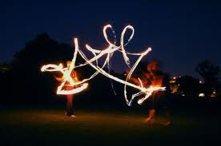
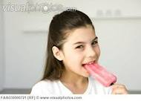
Which one goes with swiveled?

Slide 6
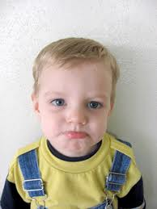
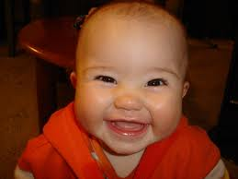
Which one goes with grinned?

Slide 7
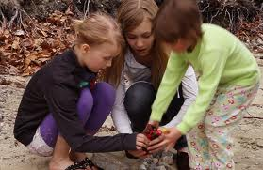
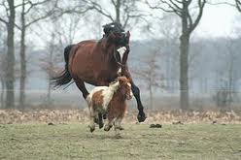
Which one goes with discovered?

Slide 8

Which word goes with this picture? swiveled, grinned or discovered?

Slide 9
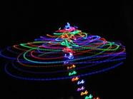
Which word goes with this picture? swiveled, grinned or discovered?

Slide 10
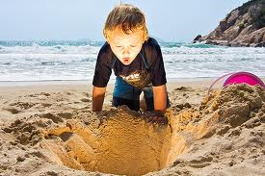
Which word goes with this picture? swiveled, grinned or discovered?

